Slide 1
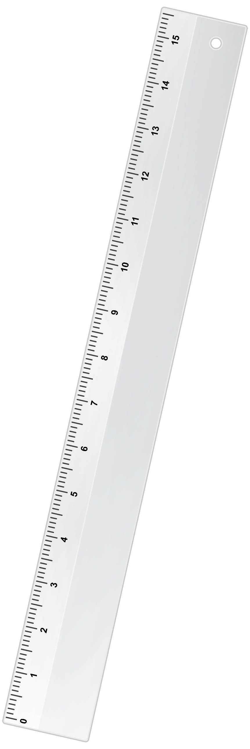

Slide 2
SCALE

Slide 3
Least Count :

Slide 4
Least Count :
The smallest value that can be measured
By the measuring instrument

Slide 5
SCALE
Definition
Representative Fraction
Classification of scale

Slide 6



Slide 7
A4 paper
Building

Slide 8
A4 paper
Building

Slide 9

Reduce to fit on paper
A4 paper
Building

Slide 10
Drawing reduce to
Some proportion to
Fit on the paper size
REDUCED SCALE

Slide 11
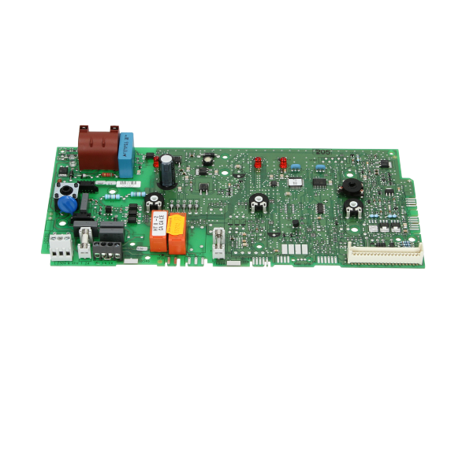
Electronic circuit
A4 paper

Slide 12
Electronic circuit
A4 paper

Slide 13
Enlarge to fit on paper
Electronic circuit
A4 paper

Slide 14
Drawing enlarge to
Some proportion to
Fit on the paper size
ENLARGE SCALE

Slide 15
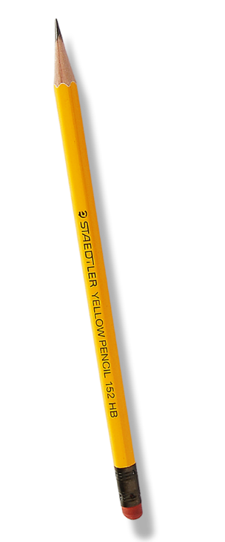
Drawing are rearly
Drawn to
ACTUAL SIZE

Slide 16
Drawing are rearly
Drawn to actual size
FULL SCALE DRAWING
Or
FULL SIZE DRAWING

Slide 17
Definition:
Proportion by which we either reduce or
Increase the actual length of the object
On the drawing is called SCALE or
SIMPLE SCALE

Slide 18
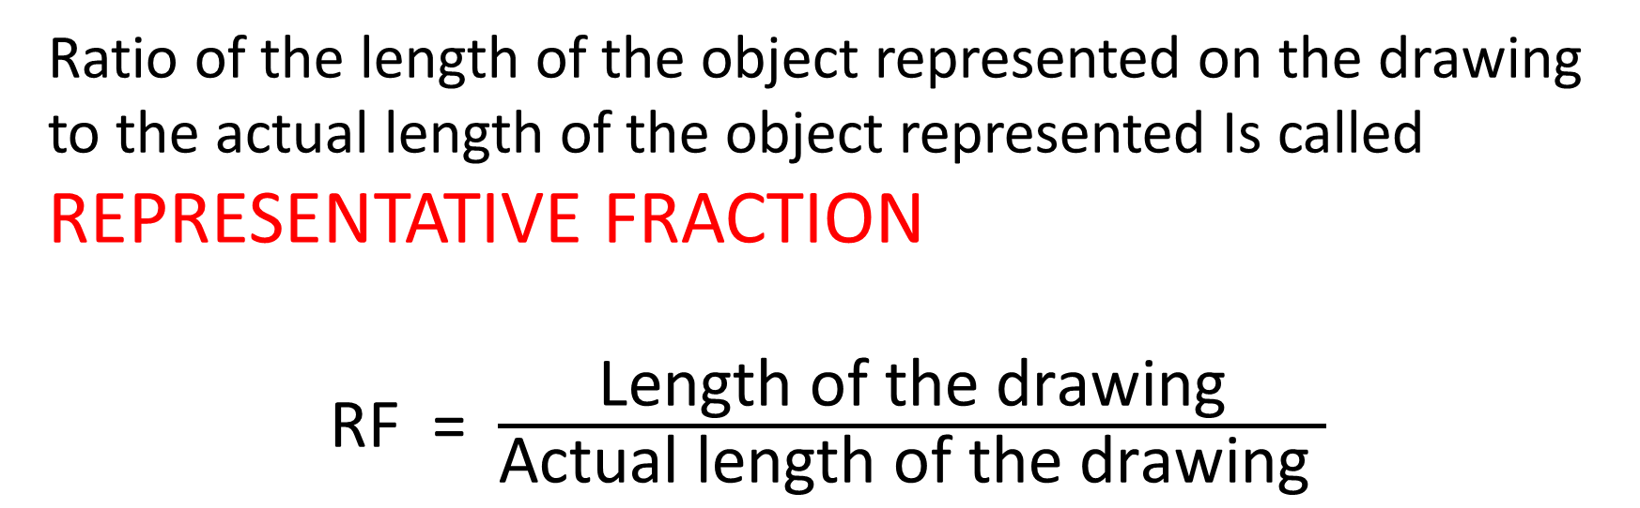
Representative Fraction(RF)
Ratio of the length of the object represented on the drawing to the actual length of the object represented Is called REPRESENTATIVE FRACTION
RF = $\frac{\text{Length} \text{of} \text{the} \text{drawing}}{\text{Actual} \text{length} \text{of} \text{the} \text{drawing} }$

Slide 19
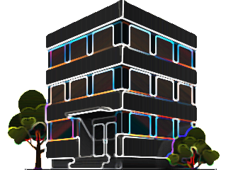



Representative Fraction
$$\text{Length} \text{of} \text{the} \text{drawing}$$
$$\text{Actual} \text{length} \text{of} \text{the} \text{drawing}$$

Slide 20


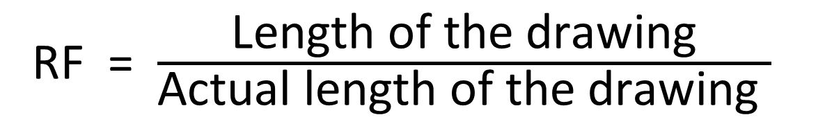
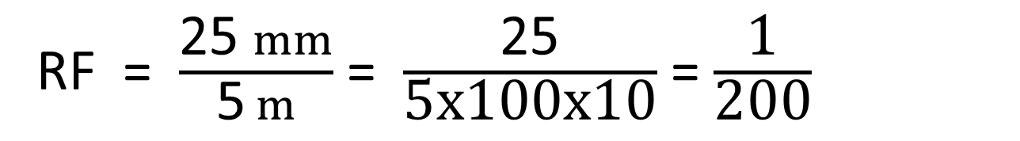
Q.
An actual length of strip is 5m is represented by
25mm length of the drawing. Then
RF = $\frac{\text{Length} \text{of} \text{the} \text{drawing}}{\text{Actual} \text{length} \text{of} \text{the} \text{drawing} }$
5m
RF = $\frac{\text{25 }mm}{\text{5} m}$
RF = $\frac{\text{25 }mm}{\text{5} m}$ = $\frac{\text{25}}{\text{5}\text{x}\text{100}\text{x}\text{10}}$ = $\frac{\text{1}}{\text{200}}$
Scale of drawing = 1:200

Slide 21
Scale of drawing = 1:200
1 unit represents 200 original units
Scale = Reduced Scale
5m

Slide 22


Q.
An actual length of strip is 10 mm is represented by
50 mm length of the drawing. Then
RF = $\frac{\text{Length} \text{of} \text{the} \text{drawing}}{\text{Actual} \text{length} \text{of} \text{the} \text{drawing} }$
RF = $\frac{\text{5}\text{0} mm}{\text{10} mm}$
10 mm
RF = $\frac{\text{5}\text{0} mm}{\text{10} mm}$ = $\frac{\text{5}}{\text{1}}$
Scale of drawing = 5:1

Slide 23
Scale of drawing = 5:1
5 unit represents 1 original units
Scale = Enlarged Scale
10 mm

Slide 24


Q.
An actual length of strip is 30 mm is represented by
30 mm length of the drawing. Then
RF = $\frac{\text{Length} \text{of} \text{the} \text{drawing}}{\text{Actual} \text{length} \text{of} \text{the} \text{drawing} }$
RF = $\frac{\text{3}\text{0} mm}{\text{30} mm}$
30mm
RF = $\frac{\text{3}\text{0} mm}{\text{30} mm}$ = $\frac{\text{1}}{\text{1}}$
Scale of drawing = 1:1

Slide 25
UNITS
Metric system
10 millimetres (mm) = 1 centimetres (cm)
10 centimetres (cm) = 1 Decimetres (dm)
10 Decimetres (dm) = 1 Metres (m)
10 Metres (m) = 1 Decametres(dam)
10 Decametres(dam) = 1 Hectometres (hm)
10 Hectometres (hm) = 1 Kilometres (km)
British system
12 inches = 1 foot
3 feet = 1 yard
220 yard = 1 furlong
8 furlong = 1 mile
1 inch = 2.54 cm

Slide 26
SCALES ON DRAWING
When an unusual scale is used, it is constructed on the drawing sheet. To construct a scale
Length of scale= R.F X Maximum length required to be measured

Slide 27


Find length of scale of a plain scale of R.F=1:500 and long enough to measure up to 40 metres
Q.
Length of scale= R.F X Maximum length required to be measured
Length of scale= $\frac{1}{500}$ X 5 metre
Length of scale= $\frac{1}{500}$ X 40 X 1000 = 80 mm

Slide 28
L.O.S = 80 mm

Slide 29
Types of Scale
Plain scale
Diagonal Scale
Vernier scale
Comparative Scale
Isometric Scale
Scale of Chord

Slide 30
Types of Scale
Plain scale
Diagonal Scale
Vernier scale
Comparative Scale
Isometric Scale
Scale of Chord

